Slide 1
Deep Learning
Generated for: RNNs, Deep Learning
Notes:
Welcome to the Deep Learning presentation covering multiple topics. Today we'll explore: RNNs, Deep Learning.

Slide 2
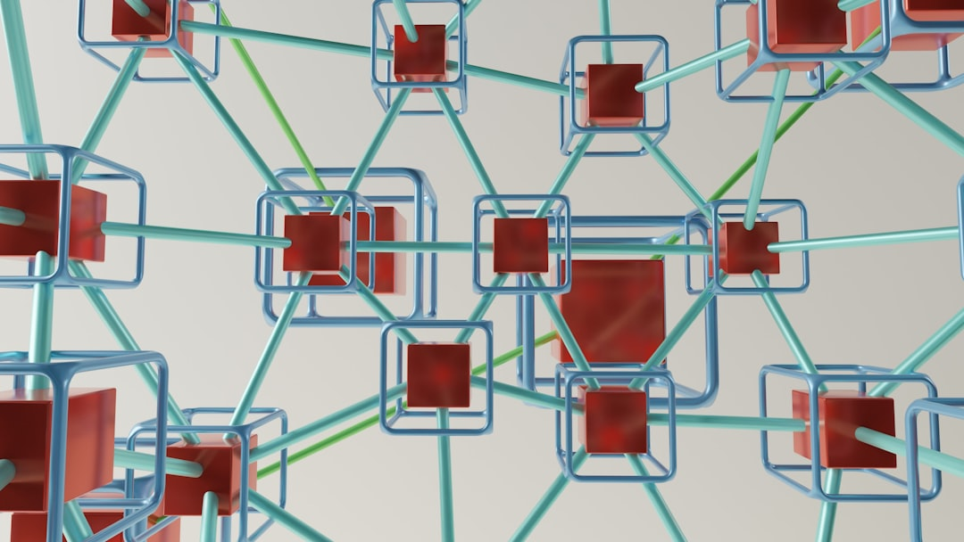
RNNs - Introduction
Recurrent Neural Networks process sequential data
RNNs have feedback connections for temporal relationships
Used for speech recognition, language modeling tasks
Can learn from experience, improve over time
Basic RNN architecture includes input, hidden, output layers
Training RNNs involves backpropagation through time
RNNs can be unidirectional or bidirectional
Unidirectional RNNs process sequences in one direction
Bidirectional RNNs process sequences in both directions
RNNs are foundation for more complex models like LSTMs
Notes:
When introducing RNNs, emphasize their ability to handle sequential data and learn from experience. Provide examples of speech recognition and language modeling tasks. Explain the basic architecture and training process, highlighting backpropagation through time. Discuss the differences between unidirectional and bidirectional RNNs. Ask students to consider scenarios where RNNs would be useful and how they can be applied to real-world problems. Key takeaways include understanding the role of feedback connections and the importance of sequence direction in RNNs.

Slide 3

RNNs - Introduction
Recurrent Neural Networks process sequential data
RNNs have feedback connections, allowing recurrence
Used for time series forecasting and prediction
Applications include speech recognition systems
RNNs learn patterns in sequential data streams
Can be trained on variable-length input sequences
RNNs use backpropagation for training purposes
Simple RNNs suffer from vanishing gradient issue
Long Short-Term Memory networks mitigate this
Gated Recurrent Units also address vanishing gradients
Notes:
When introducing RNNs, explain their ability to handle sequential data and provide examples such as speech recognition, time series forecasting, and natural language processing. Discuss the concept of recurrence and how it allows RNNs to keep track of state over time. Mention the challenges associated with training RNNs, such as the vanishing gradient problem, and introduce the concepts of LSTM and GRU as solutions. Ask students to consider how RNNs can be applied to real-world problems and what benefits they offer over traditional neural networks. Key takeaways should include understanding the basics of RNN architecture and their applications, as well as the importance of addressing the vanishing gradient issue.

Slide 4
RNNs - Introduction
Recurrent Neural Networks handle sequential data
RNNs have feedback connections for temporal relationships
Used for speech recognition and language modeling
RNNs can learn from experience and adapt
Basic RNN architecture includes input and output
Hidden state captures sequential information
Training RNNs involves backpropagation through time
RNNs suffer from vanishing gradient problem
Long Short-Term Memory helps alleviate issues
Notes:
When introducing RNNs, emphasize their ability to handle sequential data, such as speech or text. Explain the basic architecture, including the role of the hidden state in capturing temporal relationships. Provide examples of applications, like speech recognition or language modeling. Discuss the challenges of training RNNs, including the vanishing gradient problem, and introduce Long Short-Term Memory as a solution. Ask students to consider how RNNs can be applied to real-world problems, such as predicting stock prices or generating text.

Slide 5
Deep Learning - Introduction
Deep learning is a subset of machine learning methods
Inspired by the structure and function of the brain
Uses artificial neural networks with multiple layers
Enables computers to learn from data without programming
Can learn from large datasets with minimal human intervention
Applied in image recognition, speech recognition, and NLP
Requires significant computational power and memory
Has many applications in industry and academia
Includes techniques like convolutional and recurrent networks
Notes:
When introducing deep learning, explain that it's a type of machine learning that uses neural networks to learn from data. Provide examples of applications such as image recognition, speech recognition, and natural language processing. Ask students if they have any experience with machine learning or neural networks. Emphasize the importance of deep learning in industry and academia, and highlight its ability to learn from large datasets with minimal human intervention. Key takeaways include understanding the basics of deep learning and its applications.

Slide 6
Deep Learning - Introduction
Deep learning is a subset of machine learning methods.
Inspired by structure and function of human brain.
Uses artificial neural networks with multiple layers.
Enables computers to learn from data without programming.
Can learn from large amounts of data automatically.
Key aspect is automatic feature extraction.
Improves accuracy with more data and computing power.
Applications in image, speech, and natural language processing.
Requires significant computational resources and data.
Used in self-driving cars, facial recognition systems.
Notes:
When introducing deep learning, emphasize its ability to learn from large datasets without manual feature engineering. Provide examples of deep learning applications, such as image recognition, speech recognition, and natural language processing. Explain the concept of artificial neural networks and how they mimic the human brain. Ask students to consider the potential benefits and challenges of using deep learning in various industries. Key takeaways include understanding the basics of deep learning, its applications, and the importance of computational resources and data quality.

Slide 7
Deep Learning - Fundamentals
Deep learning is a subset of machine learning methods
Inspired by the structure and function of the brain
Uses artificial neural networks to analyze data
Can learn from large amounts of data automatically
Requires significant computational resources and time
Includes techniques like convolution and pooling
Used for image and speech recognition applications
Can be applied to natural language processing tasks
Requires optimization algorithms like stochastic gradient
Notes:
When discussing the fundamentals of deep learning, explain how it's a subset of machine learning and highlight its inspiration from the brain's structure. Provide examples of its applications in image recognition, such as self-driving cars, and speech recognition, like virtual assistants. Ask students to consider the challenges of requiring large datasets and significant computational resources. Key takeaways should include understanding the basic concepts of deep learning and its potential uses in various fields.

